Slide 1


SQL Part 5

Slide 2
JOIN
JOIN is used to combine rows from two or more tables based on a related column between them.
This allows you to retrieve data from multiple tables in a single query.

Slide 3
Types of Joins
INNER JOIN
Retrieves records that have matching values in both tables.

Slide 4
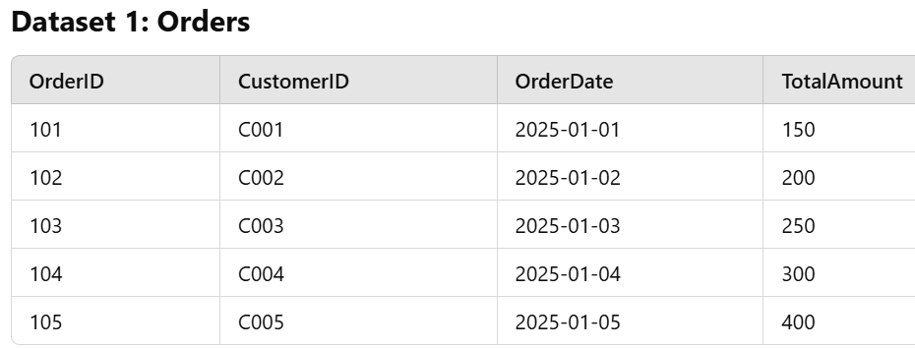
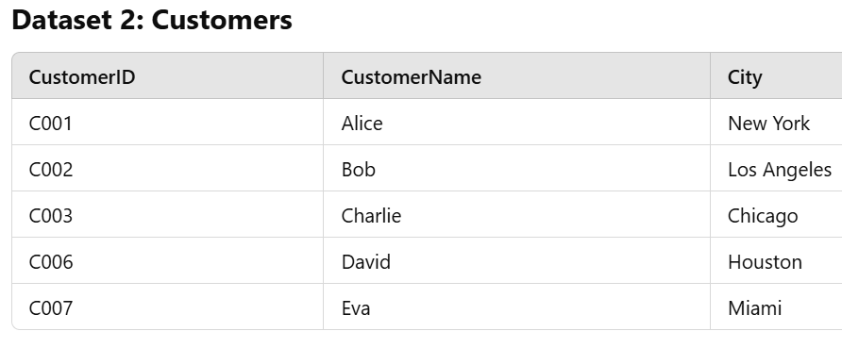

Slide 5
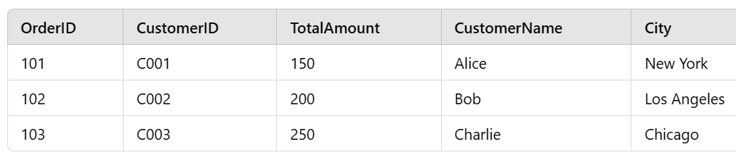

Slide 6
2. LEFT JOIN
Retrieves all records from the left table and the matched records from the right table.

Slide 8
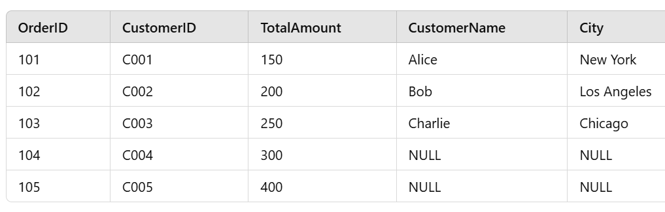

Slide 9
3. RIGHT JOIN
Retrieves all records from the right table and the matched records from the left table.

Slide 11
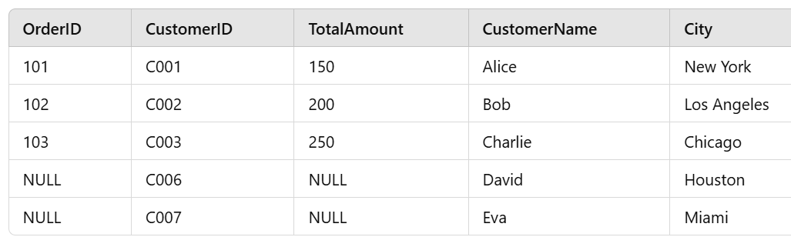

Slide 12
4. FULL JOIN
Retrieves all records when there is a match in either the left or the right table.

Slide 14
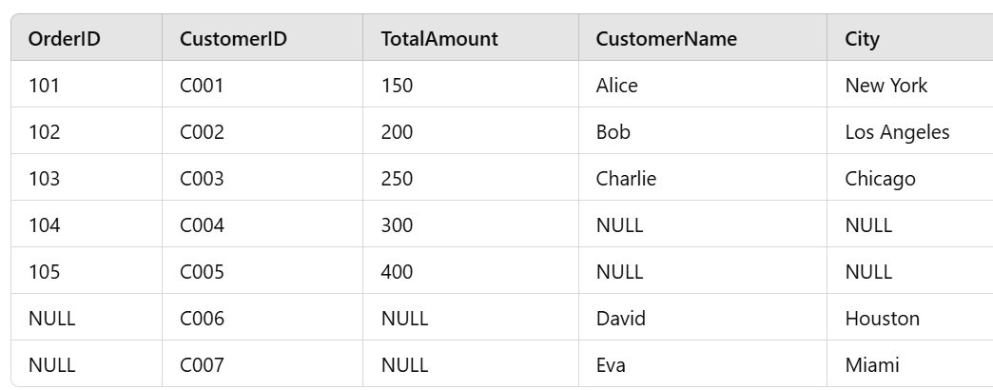

Slide 15
5. CROSS JOIN
Produces the Cartesian product of the two tables, combining every row from the first table with every row from the second table.

Slide 18
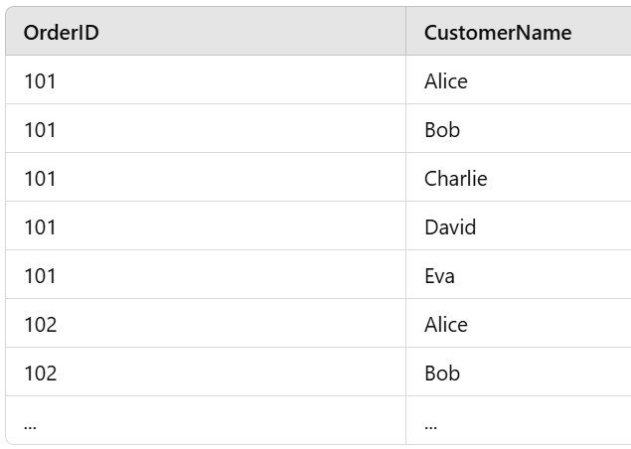

Slide 19
6. SELF JOIN Joins a table with itself.

Slide 20
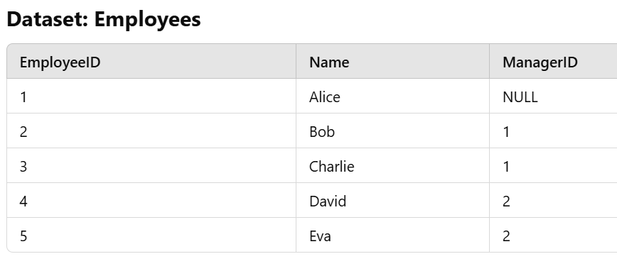

Slide 21
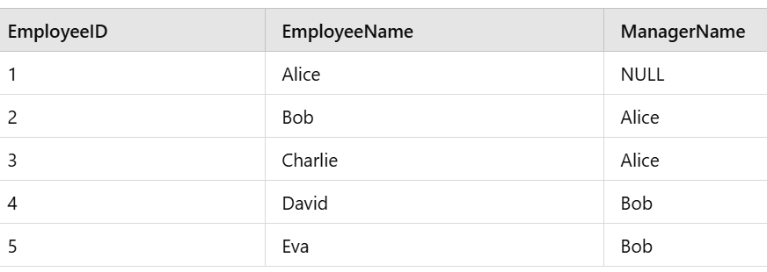
Problem: Find the employees and their corresponding managers' names.

Slide 22
SQL Set Operators
Set operators in SQL are used to combine the results of two or more SELECT queries, ensuring the combination of rows based on certain conditions.
There are four main types of set operators in SQL:
UNION {1,2,3}, {4,5,1} = {1,2,3,4,5}
UNION ALL {1,1,2,3,4,5}
INTERSECT {1}
EXCEPT (or MINUS in some databases) {2,3}

Slide 23
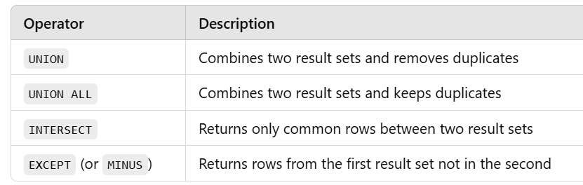

Slide 24
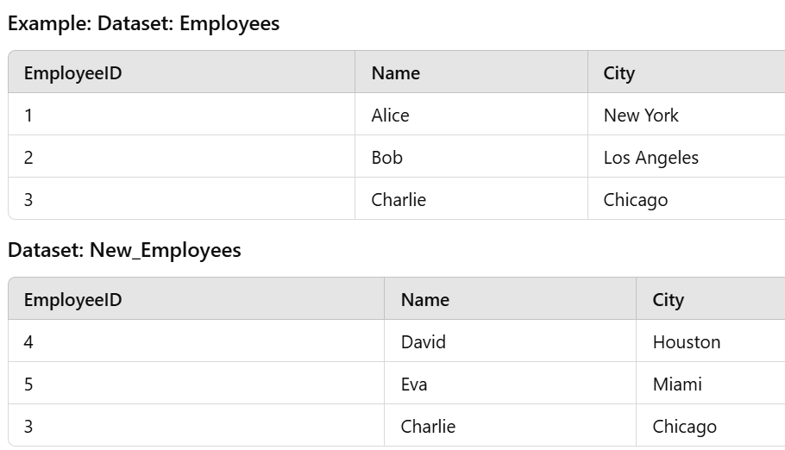

Slide 25
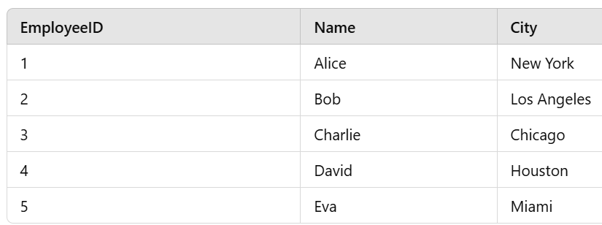
UNION

Slide 26
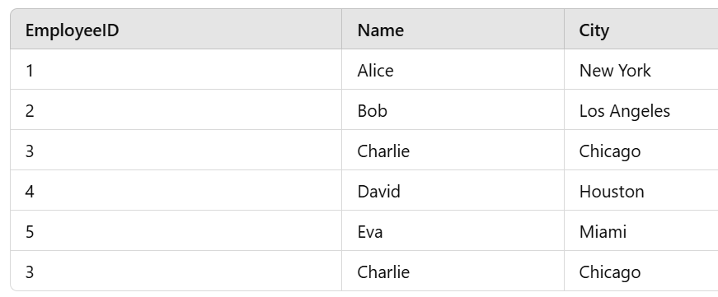
2. UNION ALL

Slide 27
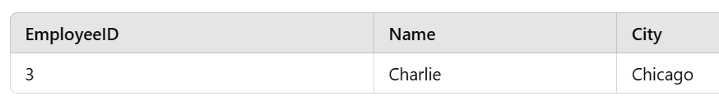
3. INTERSECT

Slide 28
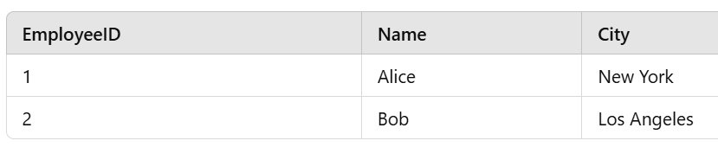
EXCEPT (or MINUS)

Slide 29
Get the full name and contact details of all customers who made a purchase.
List the sales representative's full name and the total sales amount they generated.
Find all products and their suppliers' contact details.
Retrieve the list of customers and the products they have purchased, including the quantity and total amount spent.
List all sales representatives along with the number of sales they have made.

Slide 30
6. Find the sales representative details for all sales made in a specific store location
7. Get the total sales amount for each product along with its category.
8. List all customers along with the product they have purchased and the total amount spent.
9. Retrieve the sales data including customer names and product details for a specific sales representative.
10. Find the sales representative details and the products sold by them in each region.
11. Get the full name and contact details of all customers who haven’t made a purchase.

Slide 31
Structure of CASE Statement:
SELECT column1,
column2,
CASE
WHEN condition1 THEN result1
WHEN condition2 THEN result2
ELSE result3
END as new_column
FROM table_name;

Slide 32

Thank you

